Slide 1
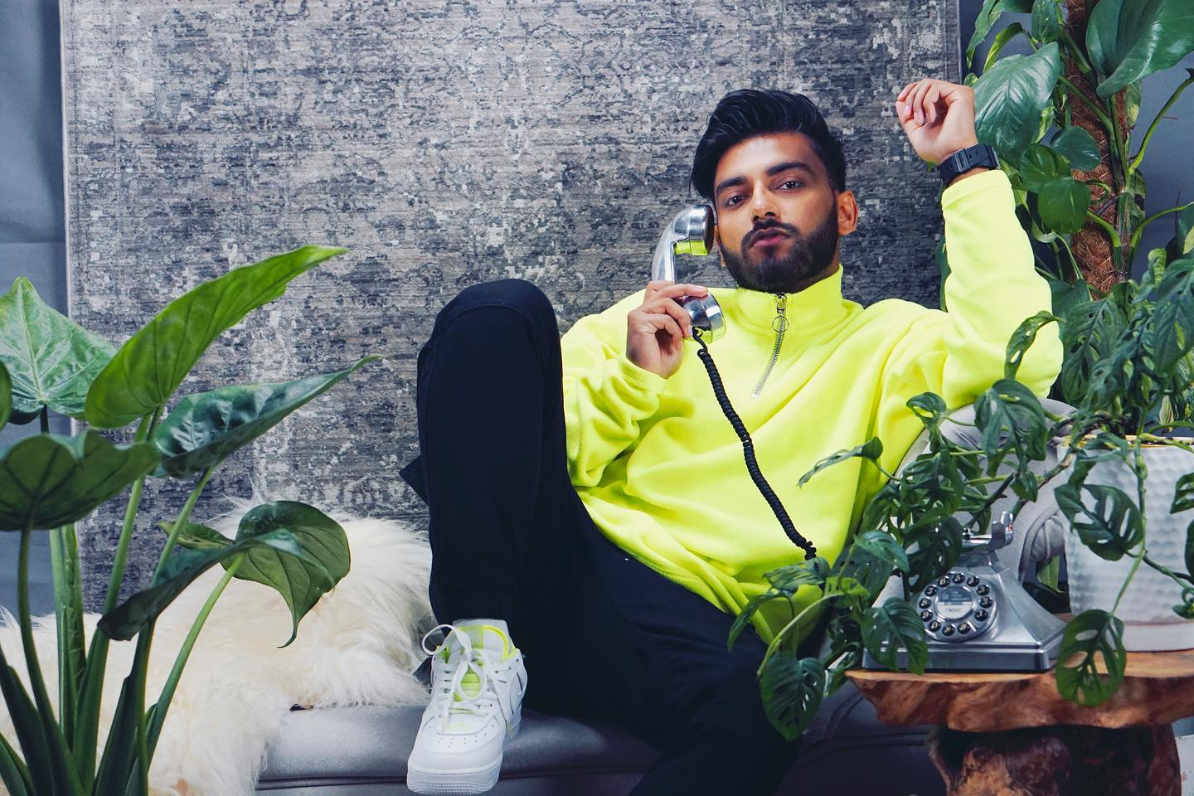

About us
APR Artist Agency is a home for a global roster of some of the world's premier talents, we focus on getting our talent the recognition they deserve.
We are passionate and generate opportunities for our clients and partners along with the unique creative visions of the artists we represent.

Slide 2

FOUNDER
The agency was founded in 2020 by Priyanka Rajendram. With her expertise in client relationships, brand partnerships and events management working for world renowned companies such as Wembley National Stadium, Marriott, Barclays and hosting multiple A list celebrities at the O2 arena, her and her team helps the artist and models shaping an integral part of their career.

Slide 3

SERVICES
Our services focus on bringing our talented artist and models together with the leading global brands through brand partnership. This elevates our client’s careers, while also focusing on our brand partners, helping them shape public perception by connecting them to the world of entertainment and media and drive engagement for both parties.

Slide 4

APR artist agency works globally, getting our clients performances, connecting our clients to opportunities in print, digital, commercials and campaigns. With our clients inventing news ways to work, inspire and connect, we help them shaping their talent, careers and telling stories to inspire the world.
CONNETING WITH BRANDS

